Slide 1
Rectifiers
Classification of Rectifiers
1. Uncontrolled rectifiers
2. Fully controlled rectifiers
line frequency ac is converted into variable voltage dc (uses controllable devices like SCRs, IGBT)
3. Half controlled converters
line frequency ac is converted into variable voltage dc (uses both uncontrollable and controllable devices)
line frequency ac is converted into fixed voltage dc.
(uses uncontrollable devices like diodes)

Slide 2
Uncontrolled and Halfcontrolled Converters
average output voltage is always positive.
Power flow is from ac source to dc load
Unidirectional converters
operating points lie in the first quadrant of Average voltage V_{d} - Average current I_{d} Plane
Single quadrant converters

Slide 3
Uncontrolled Rectifiers
APPLICATIONS
Switching power supplies
ac motor drives
dc motor drives
battery chargers
electrochemical processes
HVDC Transmission

Slide 4
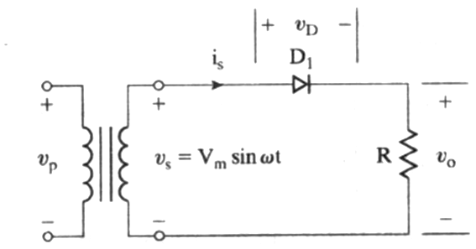
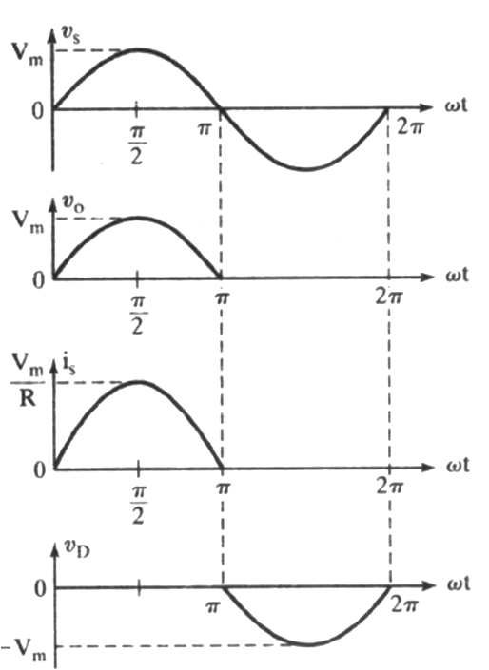
Single phase Half wave rectifier - R load
i_{d}
v_{d}
v_{d}
V_{s} = V_{m}sinωt =√2V_{s}sinωt
V_{s} – RMS value of source voltage
0 - π D₁ conducts.
v_{d}(ωt) =
i_{d}(ωt) =
Diode voltage v_{D1}(ωt) = 0
v_{s}(ωt)
v_{d}(ωt) /R =
i_{s}(ωt)
π -2π D₁ is off
i_{d} (ωt)= 0,
V_{d} (ωt)= 0
i_{s}(ωt)=0,
v_{D1} (ωt)=
v_{s}(ωt)

Slide 5

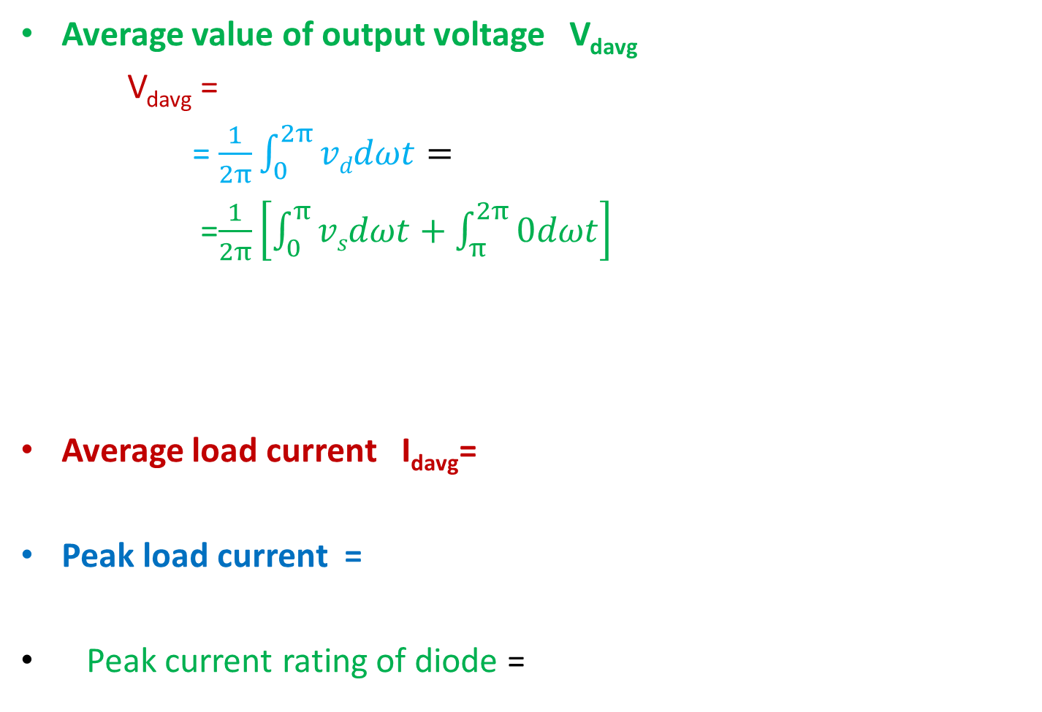
Performance parameters
Average value of output voltage V_{davg}
V_{davg} =
= $\frac{1}{2π}\int_{0}^{2π}{vddωt}=$
=$\frac{1}{2π}\left[\int_{0}^{π}{vsdωt}+\int_{π}^{2π}{0dωt}\right]$
Average load current I_{davg}=
Peak load current =
Peak current rating of diode =
= Average current rating of diode

Slide 6
RMS load voltage V_{dRMS}
RMS load current I_{dRMS} =
Load current Form factor =
RMS source current I_{sRMS} =

Slide 7
DC power delivered to the load P_{dc} = V_{davg} ^{x} I_{davg}
Transformer Utility factor TUF
DC power delivered /Transformer power rating
If transformer RMS current rating is same as I_{drms} , then
TUF =
= P_{dc} / (V_{s} × I_{dRMS}) =
29%
Power rating of transformer must be greater by 1/.29 (=3.5) times the dc load power rating

Slide 8
Rectifier efficiency η
= dc side load power/(ac load power + rectifier loss)
R_{f} ----forward resistance of diode

Slide 9
Ripple factor γ
= RMS value of ripple content in load voltage / V_{davg}
Input source pf =
=
1.21

Slide 10
Peak Inverse voltage PIV
Maximum instantaneous voltage that appears across the diode during the blocking state
=

Slide 11
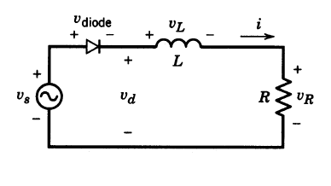
Single Phase Half wave uncontrolled Rectifier with R-L Load
i_{d}
During positive half cycle diode is on
i_{d}(0) =
0 ,
(di_{d}/dt) / _{t=0}
= 0

Slide 12


qqq
V_{L}(t) =L (di_{d}/dt) =
= V_{d}(t) - V_{R}(t

Slide 13

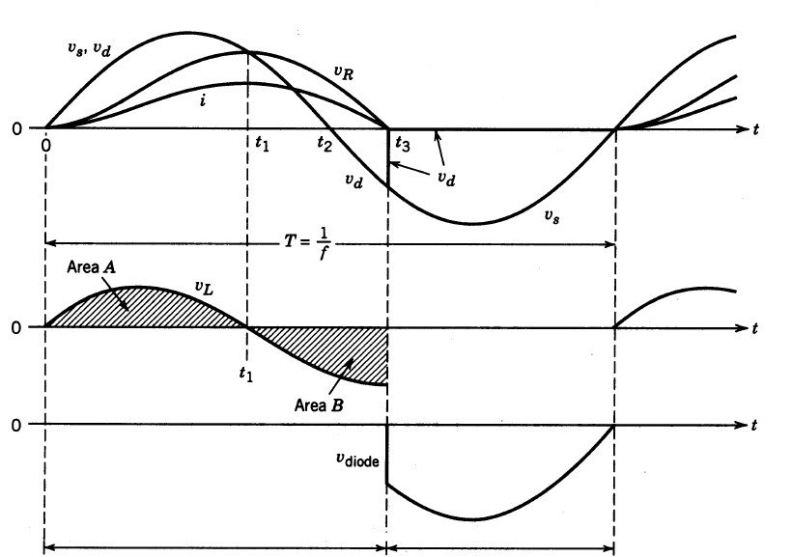
0-t3
Area A = Area B

Slide 14
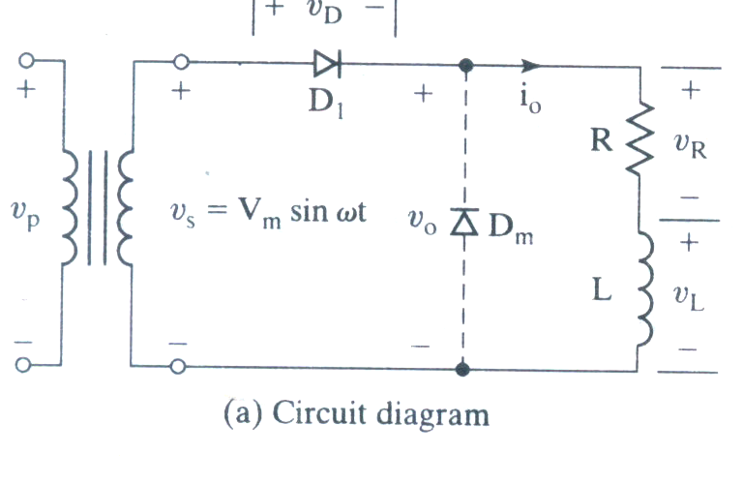
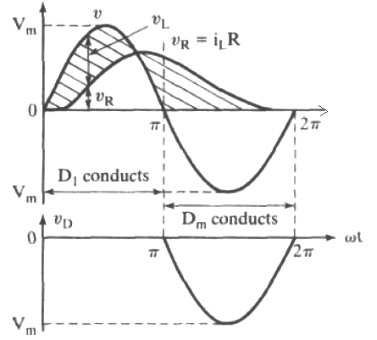
R-L load with free wheeling diode
V_{s} , i₀, v_{R}, v_{L}, v_{D1}, v_{dm}
Average voltage (and current) can be increased by adding a freewheeling diode D_{m} .
The effect of this diode is to prevent a negative voltage appearing across the load.
At t =Π/ω the current from D₁ is transferred to D_{m} and this process is called commutation of diodes.
Continuity of the load current depends on its time constant τ = ωL/R.

Slide 15
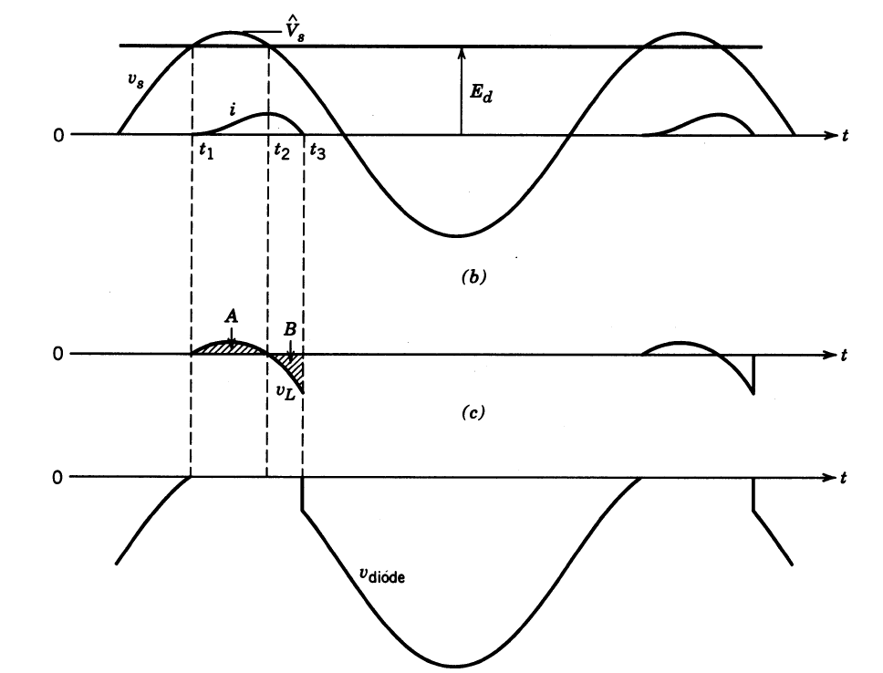
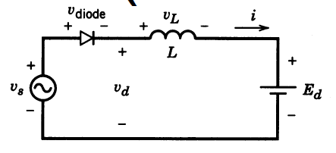
L-E load (dc motor with back emf)
v_{L} = v_{s} - E_{d}
• Diode is forward biased when V_{s} ≥ E_{d}
At ωt = ωt₁ = α; v_{s} = E_{d}
v_{diode} = v_{s} - E_{d}
√2V_{s}sin α = E_{d}
For ωt ≥ ωt_{1,} D₁ is on, V_{diode} = 0
√2V_{s}sin ω t =
Ldi/dt + E_{d}
i(t) =
At ωt = α i = 0
√2V_{s}sin α = Ldi/dt + E_{d}
di/dt /_{ωt = α} =(√2V_{s}sin α –E_{d})/L
=0

Slide 16
t₃ → 2π/ω
i = 0
di/dt = 0, v_{L} = 0
V_{diode} = v_{s}-E_{d}
• Current continues to flows for a while even after the input voltage has gone below the dc back-emf

Slide 17
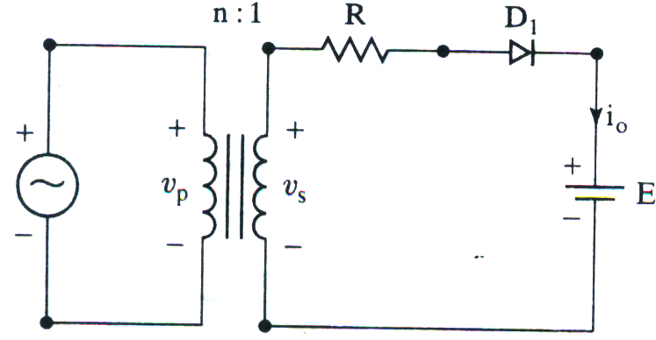
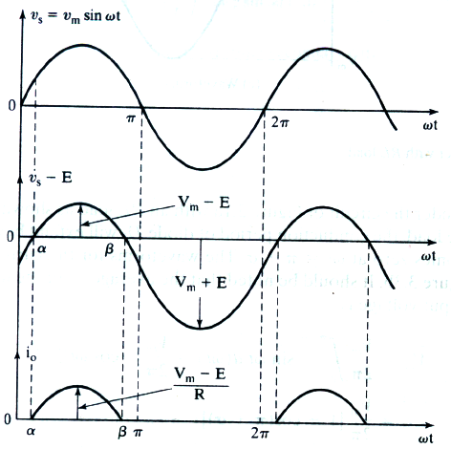

Battery charging circuit
For Vs > E, diode D1 conducts.
The charging current i0(t)
D₁ is turned off when i_{o}(t)=0 at β = (∏-α)

Slide 18
Performance parameters
Average charging current I_{0avg}
Series connected resistance R =
RMS value of Charging current I_{0RMS}2

Slide 19

P_{R} = I_{0RMS} ² × R
Rectifier efficiency =
Power delivered to battery / total input power
Peak inverse voltage of diode=
Power delivered to the battery
P_{dc} = E × I_{0avg}
Power rating of resistance R,

Slide 20
A battery has a voltage of E=12V and capacity 100Wh. The average charging current should be I_{dc} =5A. The primary input voltage is V_{p} =120V , 50Hz and the transformer has a turns ratio of 2:1.
Calculate
(a) conduction angle δ of the diode.
(b) current limiting resistor R
(c) power rating P_{R} of R (d) charging time
(e) the rectifier η and (f) PIV of diode

Slide 21
Secondary voltage =
α =
Conduction angle δ=
Average charging current = I_{dc} =
R =
Power rating of resistor =
I_{oRMS}² R =
Power delivered to the battery =
E I_{dc} =
η =
PIV =

Slide 22
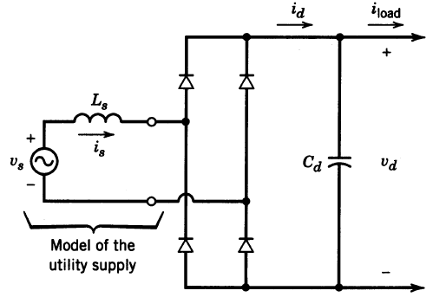

Single phase Fullwave Bridge rectifiers

Slide 23
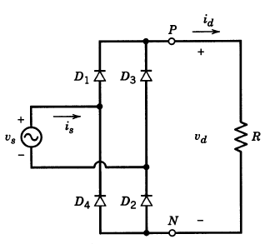
Source inductance L_{s} = 0, Load is pure resistance
0 - ∏
v_{s} is positive
D₁,D₂ forward biased
Current path is
V_{s}, D₁, load, D₂
Load voltage v_{d} =
v_{s}
Load current i_{d} =
v_{d}/R
Source current i_{s} =
i_{d}

Slide 24
∏ - 2 ∏
V_{s} is negative
D₃,D₄ forward biased
Current path is
v_{s}, D₃, load, D₄
v_{d} =
-v_{s}
i_{d} =
v_{d}/R
i_{s} =
-i_{d}

Slide 25
Performance parameters
Average load voltage V_{davg}
Average load current I_{davg}
RMS load voltage V_{dRMS}
RMS load current I_{dRMS =} V_{s}/R

Slide 26

Peak load current =
DC power delivered to the load
Transformer utility factor
PIV
Ripple factor =

Slide 27
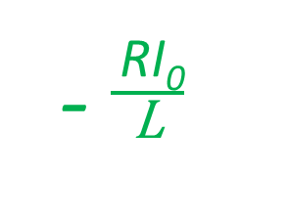

Source inductance L_{s} = 0, Load is R-L
0 - π
v_{s} is positive,
D₁,D₂ forward biased
v_{d} = v_{s ,}
i_{d}(ωt) /_{t=0} = + I₀
$\frac{\text{di}\text{d}\text{(}\text{ω}\text{t}\text{)}}{\text{d}t}\text{/}\text{ω}\text{t}\text{= 0}$ is
i_{d}(ω t) =
i_{s}(ω t) = i_{d}(ω t)
₋ $\frac{ \text{RI}\text{0}}{\text{L}}$

Slide 28

Source inductance L_{s} = 0, Load is R-L
π - 2 π
v_{s} is negative,
D₃,D₄ forward biased
v_{d} = - v_{s ,}
i_{d}(ω t) =
i_{s}(ω t) = i_{d}(ω t)
i_{d}(ωt) / _{ωt = π} = + I₀
$\frac{\text{di}\text{d}\text{(}\text{ω}\text{t}\text{)}}{\text{d}t}\text{/}\text{ω}\text{t}\text{=}\text{π}$ is $\frac{\text{−}\text{RI}\text{0}}{\text{L}}$

Slide 29
L_{s} = 0, Load is highly inductive so that i_{d} is constant at I_{d} ωL»R
0 - ∏
v_{s} is positive
D₁,D₂ forward
biased
v_{d} = v_{s}
i_{d} = I_{d}
i_{s} = +I_{d}
v_{D1} =

Slide 30
L_{s} = 0, Load is highly inductive so that i_{d} is constant at I_{d}
ωL»R
∏ -2 ∏
v_{s} is negative
D₃,D₄ forward biased
v_{d} = -v_{s}
I_{d} = I_{d}
i_{s} = -I_{d}
v_{D1} =
Average output voltage V_{davg} =
=0.9V_{s}

Slide 31
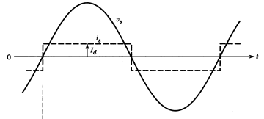



Source inductance is zero. Hence transition from positive to negative value of source current is instantaneous.
0
0

Slide 32
RMS value of fundamental component of input current
I_{s1}

Slide 33
RMS value of nth harmonic of source current i_{sn}
RMS value of total source current I_{s} =
THD of source current
Displacement factor of source current DF =
I_{d}
48.4%
cosφ₁=
1

Slide 34
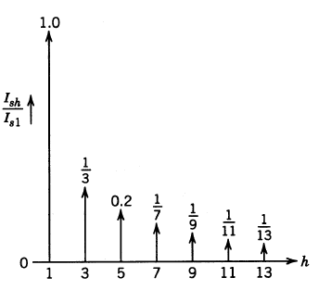
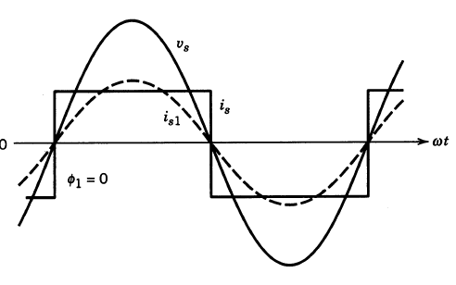
Harmonic components of Source Current
Source current and fundamental component
Harmonic components of I_{s}

Slide 35
AC source side Power factor = Actual power / Apparent power
Actual power

Slide 36

Apparent power = V_{s} I_{s}
Power Factor =
= I_{s1} / I_{s} = $\frac{\text{2}\sqrt{2}\text{I}\text{d}}{π\text{I}\text{d}}$
_{Peak current rating of diode =}
₌ I_{d}
_{RMS current rating of diode =}
₌ I_{d} $/\sqrt{2}$
_{PIV of diode =}
V_{m}

Slide 37
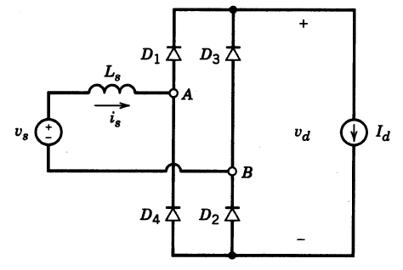
Effect of source inductance L_{s}
+ V_{Ls} -
Due to source inductance the transition of ac side current from +I_{d} to –I_{d} is not instantaneous
A finite time interval is required for the transition of current from outgoing diodes to incoming diodes.
This time interval is called current commutation period µ.

Slide 38
During the commutation
interval µ, all four diodes conduct.
V_{d} = 0
Drop in the inductance v_{Ls}
di_{s} =
+ V_{Ls} -

Slide 39

During the interval 0 to μ, i_{s} varies
from –I_{d} to +I_{d}
commutation interval µ =

Slide 40



Average voltage V_{davg} =
Average output voltage is reduced by

Slide 41
Large values of current or/and source Inductance result in larger value of µ and make average voltage zero.
V_{davg}
V_{davg}
µ=0
Slope = - 2ωLs/π
V_{davg}=0
µ= π
I_{d}

Slide 42
1. A single phase uncontrolled bridge rectifier connected to a 120V ac source supplies a constant load current of 10A.
a. If L_{s} =0, find average output voltage and average output power. Plot v_{d} and i_{s}.
b. If L_{s} =5mH, find average output voltage and average output power and overlap angle.
Plot v_{d} and i_{s}
2. Repeat the above question if input ac source is of square wave with an amplitude of 200V

Slide 43
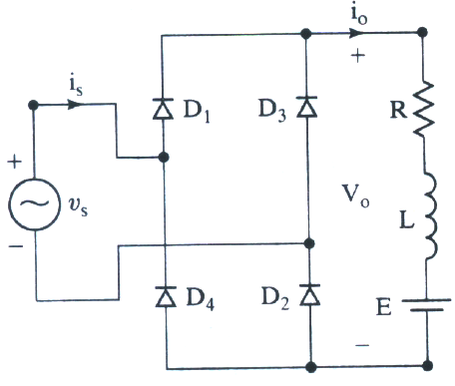
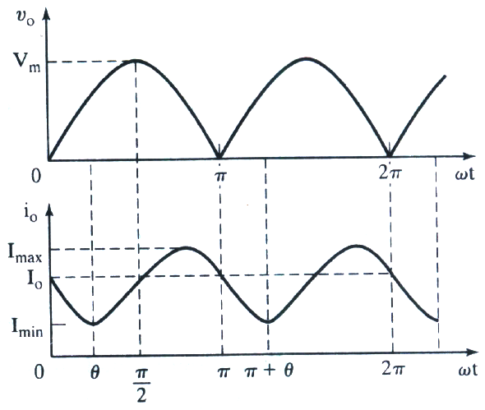
Bridge Rectifier with R-L-E load
Continuous current mode
i_{d}
i_{d}

Slide 44
i_{d}
0 - ∏ D₁ and D₂ conduct.
i_{s} reverses instantaneously from –I₀ to +I₀
v_{d} = v_{s}
At ωt = π, i_{d} = I₀
A₁ =
i_{d} =

Slide 45

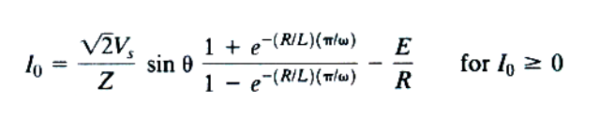
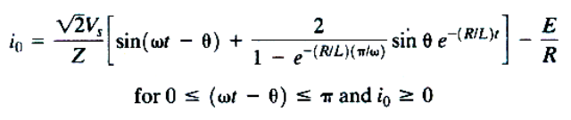
i_{d}
i_{d}
i_{d}

Slide 46
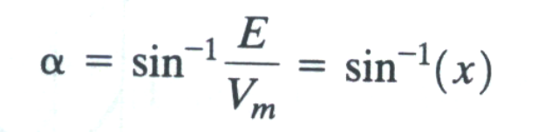


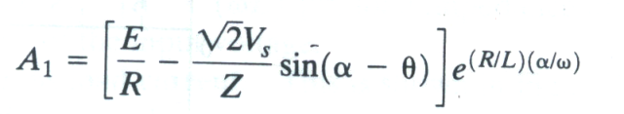

Discontinuous current mode
i_{d}
The diode starts to conduct at ωt = α
i_{d}
i_{d}
i_{d}

Slide 47




i_{d}
β can found from the above relation.

Slide 48
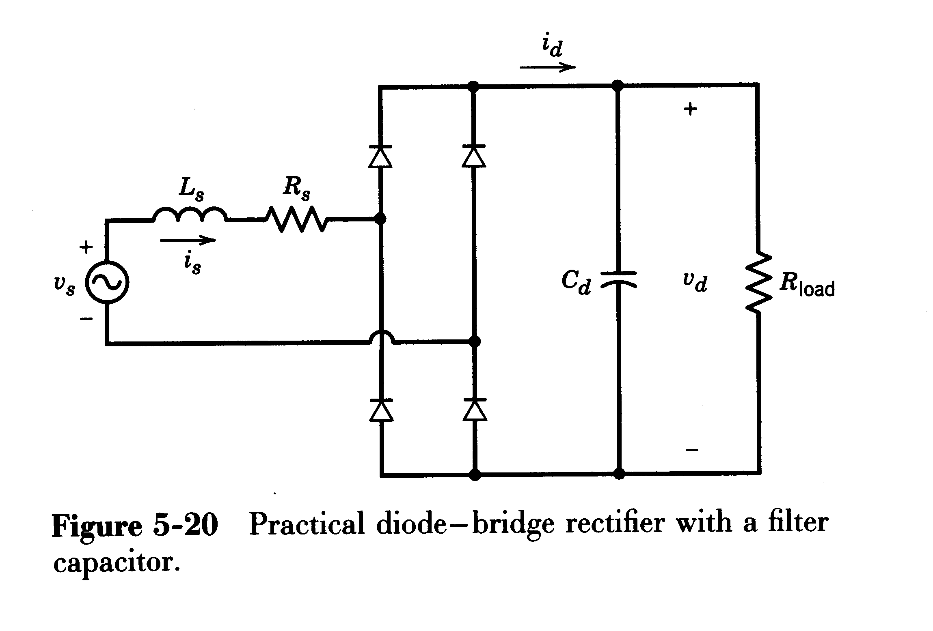
Diode Bridge rectifier with a Capacitor Filter (approximately constant potential at dc load side)
The previously charged capacitor filters the rectified voltage to make v_{d} smooth.
This voltage is used as the input for inverter or dc-dc converter
i_{R} = v_{d}/R is the current through load resistor.
i_{d} = i_{c} + i_{R}
i_{c}
i_{R}

Slide 49
t₁ = θ₁/ω and t₄ = θ₄/ω
t₁ < t < t₄
v_{s} = R_{s} i_{d} + L_{s} di_{d}/dt + v_{d}
i_{d} = C_{d} dv_{d}/dt + v_{d}/R_{load}

Slide 50
t₄ < t < t₁+T/2 All Diodes are off
C_{d} dv_{d}/dt = - v_{d}/R_{load}
dv_{d}/dt = - v_{d}/ C_{d} R_{load}
v_{d} (t) =
v_{d} (t₄) e^{-(t-t4) C}_{d} ^{R}_{load}

Slide 51
Course Outcome
CO1:Acquire knowledge about analysis and design of various types of DC Chopper circuits
CO2: Acquire knowledge about harmonic analysis and filter circuit design of uncontrolled rectifiers
CO3: Acquire knowledge about various types of controlled rectifiers
CO4: Acquire knowledge about various PWM techniques of 2-level DC to AC converters
CO5: Acquire knowledge about analysis of multilevel inverters with advanced PWM techniques

Slide 52
Effect of diode rectifier on utility voltage & Current
Line current distortion
Source current deviates significantly from the sinusoidal waveform.
Line voltage distortion
Distortion in the line current results in the distortion of line voltage waveform.

Slide 53
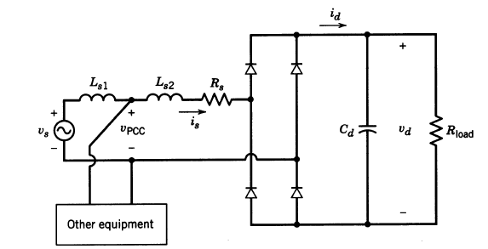
L_{s1} – Inductance of the utility side
L_{s2}- Inductance due to the power electronic equipment
R_{s}-represents the diode resistance
PCC- point of common coupling where other loads and power electronic load are connected
V_{pcc} Voltage across the PE equipment and other loads at the point of common coupling

Slide 54
Source current i_{s}
Distortion in voltage at PCC due to harmonics in line current

Slide 55
Voltage available at the point of common coupling is highly deviated from the ideal sine waveform
This is usually referred to voltage pollution in power system
This is one of the reasons of power quality problems

Slide 56
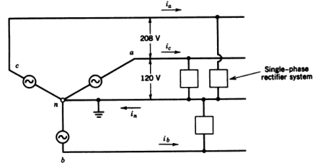
Effect of Single phase rectifiers on the neutral current in 3Ф 4 wire systems
When all the 3 phases are loaded equally or balanced, neutral current i_{n} = 0.
When single phase rectifiers are connected as load to 3Ф , i_{n} ≠ 0
Consider identical rectifiers connected between each phase and neutral (balanced load condition)

Slide 57

Phase a current
i_{a}$=\sqrt{2}I_{s1}sin\left(ωt−φ1\right)+\sum_{n=2k+1}^{∞}{\left({\sqrt{2}I_{sn}}_{}sin\left(nωt−φn\right){}\right)}$
k=1,2,3,….

Slide 58
Sum of the three phase fundamental components and non-triplen harmonics is zero.
i_{a1} + i_{b1} + i_{c1} = 0
Neglecting all higher order harmonics,
Thus, neutral wire carries 3 times 3rd harmonic current flowing through a phase
neutral current is almost equal to or greater than the fundamental line current.
Neutral current i_{N} = i_{a} + i_{b} + i_{c}
i_{N} = i_{a3} + i_{b3} + i_{c3}
= 3 i_{a3} ≈i_{a1}

Slide 59
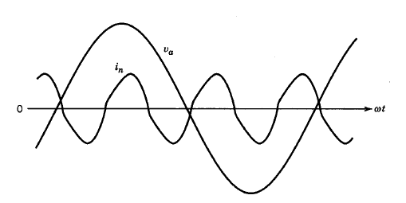
Neutral current

